Slide 1



Chapter 5
Interaction Design Basics
1

Slide 2
Interaction Design Basics
Design
What It Is, Interventions, Goals, Constraints
The Design Process
What Happens When
Users
Who They Are, What They Are Like …
Scenarios
Rich Stories Of Design
Navigation
Finding Your Way Around A System
Iteration And Prototypes
Never Get It Right First Time!
2

Slide 3
Interactions and Interventions
Design interactions not just interfaces
not just the immediate interaction
e.g. stapler in office – technology changes interaction style
manual: write, print, staple, write, print, staple, …
electric: write, print, write, print, …, staple
Designing interventions not just artifacts
not just the system, but also …
documentation, manuals, tutorials
what we say and do as well as what we make
3

Slide 4
Design
4
Notes:
4

Slide 5
What Is Design?
achieving goals within constraints
Goals – What is the purpose of the design we are intending to produce? Who is it for? Why do they want it?
For example, if we are designing a wireless personal movie player, we may think about young affluent users wanting to watch the latest movies whilst on the move and download free copies, and perhaps wanting to share the experience with a few friends.
Constraints – What materials must we use? What standards must we adopt? How much can it cost? How much time do we have to develop it? Are there health and safety issues?
In the case of the personal movie player: does it have to withstand rain? Must we use existing video standards to download movies? Do we need to build in copyright protection?
5
Notes:
5

Slide 6
What Is Design? (cont.)
Trade-off – Choosing which goals or constraints can be relaxed so that others can be met. For example, we might find that an eye-mounted video display, a bit like those used in virtual reality, would give the most stable image whilst walking along. However, this would not allow you to show friends, and might be dangerous if you were watching a gripping part of the movie as you crossed the road.
6
Notes:
6

Slide 7
Golden Rule Of Design
understand your materials
Part of the understanding we need is about the circumstances and context of the particular design problem.
The designs we produce may be different, but often the raw materials are the same.
Look at a chair with a steel frame and one with a wooden frame. They are very different: often the steel frames are tubular or thin L or H section steel. In contrast wooden chairs have thicker solid legs. If you made a wooden chair using the design for a metal one it would break; if you made the metal one in the design for the wooden one it would be too heavy to move.
7
Notes:
7

Slide 8
For Human–computer Interaction
Understand computers
limitations, capacities, tools, platforms
Understand people
psychological, social aspects
human error
And their interaction …
8
Notes:
8

Slide 9
To err is human
accident reports ..
aircrash, industrial accident, hospital mistake
enquiry … blames … ‘human error’
but …
concrete lintel breaks because too much weight
blame ‘lintel error’ ? … no – design error we know how concrete behaves under stress
human ‘error’ is normal
we know how users behave under stress
so design for it!
treat the user at least as well as physical materials!
9

Slide 10
Central message …
The user
Often it is said that the success of the various methods used in HCI lies not in how good they are, but in that they simply focus the mind of the designer on the user.
This is the core of interaction design: put the user first, keep the user in the center and remember the user at the end.
10

Slide 11
The Design Process
11
Notes:
11

Slide 12
The process of design
scenarios task analysis
what is wanted
guidelines
principles
analysis
interviews
ethnography
what is there
vs.
what is wanted
precise specification
design
dialogue notations
implement
and deploy
evaluation
heuristics
prototype
architectures
documentation
help
N.B.: Heuristics are mental shortcuts that allow people to solve problems and make judgements quickly and efficiently.
12

Slide 13
The process of design (cont.)
Requirements
What is there and what is wanted. There are a number of techniques used for this in HCI: interviewing people, videotaping them, looking at the documents and objects that they work with, observing them directly.
Analysis
Ordering and understanding: The results of observation and interview need to be ordered in some way to bring out key issues and communicate with later stages of design.
13

Slide 14
The process of design (cont.)
Design
What to do and how to decide
Iteration and prototyping
Getting it right … and finding what is really needed! : Humans are complex and we cannot expect to get designs right first time. We therefore need to evaluate a design to see how well it is working and where there can be improvements.
14

Slide 15
The process of design (cont.)
Implementation and deployment
Making it and getting it out there : when we are happy with our design, we need to create it and deploy it. This will involve writing code, perhaps making hardware, writing documentation and manuals – everything that goes into a real system that can be given to others.
15

Slide 16
… but how can I do it all ! !
limited time ⇒ design trade-off
usability?
finding problems and fixing them?
deciding what to fix?
which usability problems is it worth fixing?
a perfect system is badly designed
too good ⇒ too much effort in design
Rather to find radically different solutions that have a major effect but are cheap to implement.


16

Slide 17
The Users
17

Slide 18
User Focus
Know your user
Personae
Cultural probes
18

Slide 19
Know Your User
Who are they?
Probably not like you!
Talk to them
Watch them
Use your imagination
19

Slide 20
Persona : Example
Betty is 37 years old. She has been Warehouse Manager for five years and worked for Simpkins Brothers Engineering for twelve years. She didn’t go to university, but has studied in her evenings for a business diploma. She has two children aged 15 and 7 and does not like to work late. She did part of an introductory in-house computer course some years ago, but it was interrupted when she was promoted and could no longer afford to take the time. Her vision is perfect, but her right-hand movement is slightly restricted following an industrial accident 3 years ago. She is enthusiastic about her work and is happy to delegate responsibility and take suggestions from her staff. However, she does feel threatened by the introduction of yet another new computer system (the third in her time at SBE).
20

Slide 21
Persona (cont.)
Description of an ‘example’ user
Not necessarily a real person
Use as surrogate user
What would betty think
Details matter
Makes her ‘real’
21

Slide 22
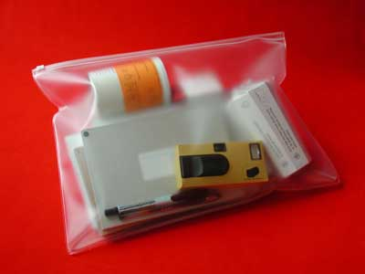
Cultural Probes
Used as one way to gather rich views of an
area without intrusion
Direct observation
Sometimes hard
In the home
Psychiatric patients, …
Probe packs
Items to prompt responses
E.g. Glass to listen at wall, camera, postcard
Given to people to open in their own environment they record what is meaningful to them
Used to …
Inform interviews, prompt ideas, enculture designers
22

Slide 23
Scenarios
Stories for design
Use and reuse
23

Slide 24
Scenarios
Stories for design
Communicate with others – other designers, clients or users. It is easy to misunderstand each other whilst discussing abstract ideas. Concrete examples of use are far easier to share.
Validate other models – A detailed scenario can be ‘played’ against various more formal representations such as task models (discussed in Chapter 15) or dialog and navigation models (Chapter 16 and below).
Express dynamics – Individual screen shots and pictures give you a sense of what a system would look like, but not how it behaves.
24
Notes:
24

Slide 25
Scenarios (cont.)
Linearity - This linearity has both positive and negative points:
Time is linear Our lives are linear as we live in time and so we find it easier to understand simple linear narratives. We are natural storytellers and story listeners.
But no alternatives Real interactions have choices, some made by people, some by systems. A simple scenario does not show these alternative paths. In particular, it is easy to miss the unintended things a person may do.
25
Notes:
25

Slide 26
Scenarios (cont.)
What will users want to do?
Step-by-step walkthrough
What can they see (sketches, screen shots) ?
What do they do (keyboard, mouse etc.) ?
What are they thinking?
Use and reuse throughout design
26

Slide 27
Scenario – Movie Player
Brian would like to see the new film “Moments of Significance” and wants to invite Alison, but he knows she doesn’t like “arty” films. He decides to take a look at it to see if she would like it and so connects to one of the movie sharing networks. He uses his work machine as it has a higher bandwidth connection, but feels a bit guilty. He knows he will be getting an illegal copy of the film, but decides it is OK as he is intending to go to the cinema to watch it. After it downloads to his machine he takes out his new personal movie player. He presses the ‘menu’ button and on the small LCD screen he scrolls using the arrow keys to ‘bluetooth connect’ and presses the select button. On his computer the movie download program now has an icon showing that it has recognised a compatible device and he drags the icon of the film over the icon for the player. On the player the LCD screen says “downloading now”, a percent done indicator and small whirling icon. … … …
27

Slide 28
Scenario - Explore the depths
Explore interaction
What happens when
Explore cognition
What are the users thinking
Explore architecture
What is happening inside
28

Slide 29
Navigation
29
Notes:
29

Slide 30
Navigation Design
the systems
info and help
management
messages
start
add user
remove user
Local structure – single screen
Global structure – whole site
main
screen
remove
user
confirm
add user
30

Slide 31
Levels
Widget choice
Menus, buttons etc.
Screen design
Application navigation design
Environment
Other apps, O/S
31

Slide 32
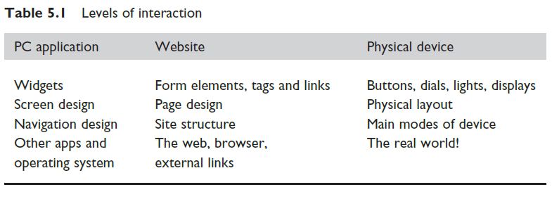
Levels of Interaction
32

Slide 33
Think About Structure
Just in case you haven’t already got the idea, the place to start when considering the structure of an application is to think about actual use:
who is going to use the application?
how do they think about it?
what will they do with it?
33

Slide 34
Think About Structure (cont.)
Within a screen
Later ...
Local
Looking from one screen or page out
Global
Structure of site, movement between screens
Wider still
Relationship with other applications
34

Slide 35
Local
Looking from one screen or page out
Much of interaction involves goal-seeking behavior.
Users have some idea of what they are after and a partial model of the system.
In an ideal world if users had perfect knowledge of what they wanted and how the system worked they could simply take the shortest path to what they want, pressing all the right buttons and links.
However, in a world of partial knowledge users meander through the system.
The important thing is not so much that they take the most efficient route, but that at each point in the interaction they can make some assessment of whether they are getting closer to their (often partially formed) goal.
35
Notes:
35

Slide 36
Goal Seeking
goal
start
36

Slide 37
Goal Seeking (cont.)
goal
start
progress with local knowledge only ...
37

Slide 38
Goal Seeking (cont.)
goal
start
… but can get to the goal
38

Slide 39
Goal Seeking (cont.)
goal
start
… try to avoid these bits!
39

Slide 40
Four Golden Rules
Knowing where you are
Knowing what you can do
Knowing where you are going
Or what will happen
Knowing where you’ve been
Or what you’ve done
40

Slide 41
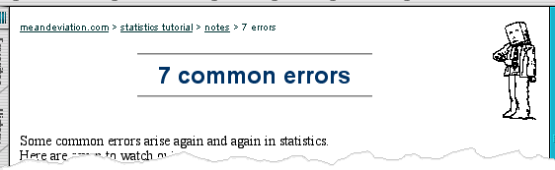
Where You Are – Breadcrumbs
shows path through web site hierarchy
top level category
sub-category
web site
this page
live links
to higher
levels
41

Slide 42
What you can do – Links
What can be pressed or clicked to go somewhere or do something.
Some web pages are particularly bad in that it is unclear which images are pure decoration and which are links to take you somewhere.
On the web the standard underlined links make it clear which text is clickable and which is not.
However, in order to improve the appearance of the page many sites change the color of links and may remove the underline too.
This is especially confusing if underline is then used as simple emphasis on words that are not links!
The trade-off between appearance and ease of use may mean that this is the right thing to do, but you should take care before confusing the user needlessly.
42

Slide 43
Where You Are Going - Beware The Big Button Trap
things
other things
more things
the thing from
outer space
where do they go?
lots of room for extra text!
43

Slide 44
Where You Are Going - Modes
Special care has to be taken if the same command or button press means something different in different contexts.
These different contexts that change the interpretation of commands are called modes.
44

Slide 45
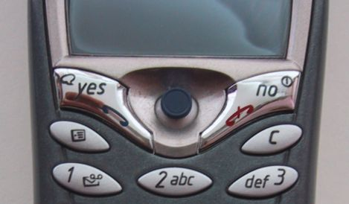
Where You Are Going – Modes (cont.)
Lock to prevent accidental use …
Remove lock - ‘c’ + ‘yes’ to confirm
Frequent practiced action
If lock forgotten
In pocket ‘yes’ gets pressed
Goes to phone book
In phone book … ‘c’ – delete entry ‘yes’ – confirm … oops !
45

Slide 46
Global - hierarchical organization
The overall structure of an application.
This is the way the various screens, pages or device states link to one another.
One way to organize a system is in some form of hierarchy.
This is typically organized along functional boundaries (that is, different kinds of things), but may be organized by roles, user type, or some more esoteric breakdown such as modules in an educational system.
This sort of hierarchy can be used purely to help during design, but can also be used to structure the actual system.
For example, this may reflect the menu structure of a PC application or the site structure on the web.
46
Notes:
46

Slide 47
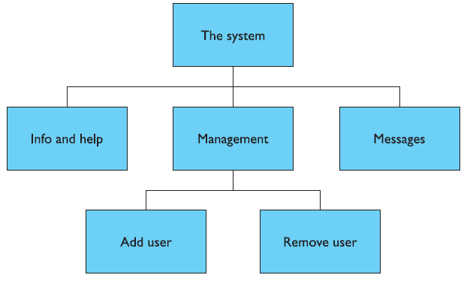
Hierarchical Diagrams
Gives a high-level breakdown of some sort of messaging system.
47

Slide 48
Navigating Hierarchies
Deep is difficult!
Misuse of miller’s 7 ± 2
Short term memory, not menu size
Optimal?
Many items on each screen
But structured within screen
48
see /e3/online/menu-breadth/

Slide 49
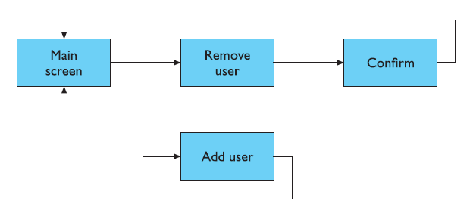
Network Diagrams
Show different paths through system

Slide 50
Network Diagrams (cont.)
A simple way is to use a network diagram showing the principal states or screens linked together with arrows. This can:
Show what leads to what
Show what happens when
Include branches and loops
Be more task oriented than
a hierarchy.

Slide 51
Wider Still
Between applications
And beyond ...
51
Notes:
51

Slide 52
Wider Still (cont.)
Style issues
We should normally conform to platform standards, such as positions for menus on a PC application, to ensure consistency between applications. For example, on our proposed personal movie player we should make use of standard fast-forward, play and pause icons.
Functional issues
On a PC application we need to be able to interact with files, read standard formats and be able to handle cut and paste.
Navigation issues
We may need to support linkages between applications, for example allowing the embedding of data from one application in another, or, in a mail system, being able to double click an attachment icon and have the right application launched for the attachment.
52

Slide 53
Screen Design And Layout
53
Notes:
53

Slide 54
Screen Design And Layout
✔
Dix , Alan
Finlay, Janet
Abowd, Gregory
Beale, Russell
Tools for layout
User action and control
Appropriate appearance
ABCDEFGHIJKLM
NOPQRSTUVWXYZ
54

Slide 55
Basic Principles
Ask
What is the user doing?
Think
What information is required?
What comparisons may the user need to make?
In what order are things likely to be needed?
Design
Form follows function: let the required interactions drive the layout.
55

Slide 56
Available Tools
Grouping of items
Order of items
Decoration - fonts, boxes etc.
Alignment of items
White space between items
56

Slide 57
Grouping And Structure
logically together ⇒ physically together
Billing details:
Name
Address: …
Credit card no
Delivery details:
Name
Address: …
Delivery time
Order details:
item quantity cost/item cost
size 10 screws (boxes) 7 3.71 25.97
…… … … …
57

Slide 58
Order Of Groups And Items
Think! - What is natural order
Should match screen order!
Use boxes, space etc.
Set up tabbing right!
Instructions
Beware the cake recipie syndrome! … Mix milk and flour, add the fruit after beating them
58

Slide 59
Decoration
Use boxes to group logical items
Use fonts for emphasis, headings
But not too many!!
ABCDEFGHIJKLM
NOPQRSTUVWXYZ
59

Slide 60
Alignment - Text
You read from left to right (english and european)
⇒ align left hand side
boring but
readable!
Willy Wonka and the Chocolate Factory
Winston Churchill - A Biography
Wizard of Oz
Xena - Warrior Princess
Willy Wonka and the Chocolate Factory
Winston Churchill - A Biography
Wizard of Oz
Xena - Warrior Princess
fine for special effects but hard to scan
60

Slide 61
Alignment - Names
Usually scanning for surnames ⇒ make it easy!
🗶
✔
Alan Dix
Janet Finlay
Gregory Abowd
Russell Beale
Dix , Alan
Finlay, Janet
Abowd, Gregory
Beale, Russell
✔
Alan Dix
Janet Finlay
Gregory Abowd
Russell Beale
61

Slide 62
Alignment - Numbers
think purpose!
which is biggest?
532.56 179.3 256.317 15 73.948 1035 3.142 497.6256
62

Slide 63
Alignment – Numbers (cont.)
visually:
long number = big number
align decimal points
or right align integers
627.865 1.005763 382.583 2502.56 432.935 2.0175 652.87 56.34
63

Slide 64
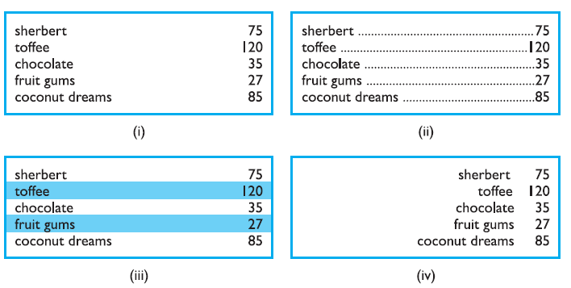
Multiple Columns
64

Slide 65
White Space - The Counter
In typography the space between the letters is called the counter.
In painting this is also important and artists may focus as much on the space between the foreground elements such as figures and buildings as on the elements themselves.
Often the shape of the counter is the most important part of the composition of a painting and in calligraphy and typography the balance of a word is determined by giving an even weight to the counters.
WHAT YOU SEE
65

Slide 66
White Space - The Counter (cont.)
WHAT YOU SEE
THE GAPS BETWEEN
66

Slide 67
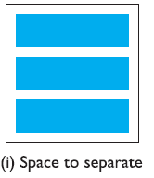
Space To Separate
67

Slide 68
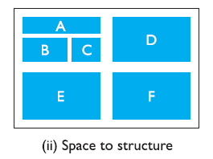
Space To Structure
68

Slide 69
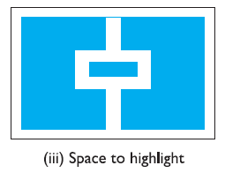
Space To Highlight
69

Slide 70
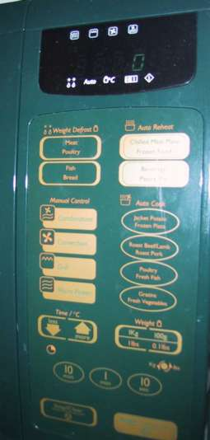
Physical Controls
grouping of items
defrost settings
type of food
time to cook
defrost settings
type of food
time to cook
70

Slide 71
Physical Controls (cont.)
grouping of items
order of items
type of heating
temperature
time to cook
start
1) type of heating
1
2) temperature
3) time to cook
2
4) start
3
4
71

Slide 72
Physical Controls (cont.)
grouping of items
order of items
decoration
different colours for different functions
lines around related buttons
different colours for different functions
lines around related buttons (temp up/down)
72

Slide 73
Physical Controls (cont.)
grouping of items
order of items
decoration
alignment
centered text in buttons ? easy to scan ?
centred text in buttons
? easy to scan ?
73

Slide 74
Physical Controls (cont.)
grouping of items
order of items
decoration
alignment
white space
gaps to aid grouping
gaps to aid grouping
74

Slide 75
User Action And Control
Entering information
Knowing what to do
Affordances
75

Slide 76
Entering Information
Name:
Alan Dix
Address:
Lancaster
Forms, dialogue boxes
Presentation + data input
Similar layout issues
Alignment - N.B. Different label lengths
Logical layout
Use task analysis (ch15)
Groupings
Natural order for entering information
Top-bottom, left-right (depending on culture)
Set tab order for keyboard entry
✔
Name:
Alan Dix
Address:
Lancaster
?
Name:
Alan Dix
Address:
Lancaster
76
N.B. see extra slides for widget choice

Slide 77
Knowing What To Do
What is active what is passive
Where do you click
Where do you type
Consistent style helps
E.g. Web underlined links
Labels and icons
Standards for common actions
Language – bold = current state or action
77

Slide 78
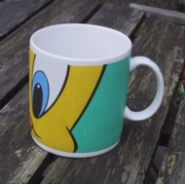
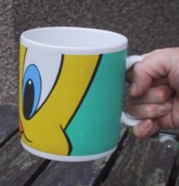
Affordances
mug handle
Psychological term
For physical objects
Shape and size suggest actions
Pick up, twist, throw
Also cultural – buttons ‘afford’ pushing
For screen objects
Button–like object ‘affords’ mouse click
Physical-like objects suggest use
Culture of computer use
Icons ‘afford’ clicking
Or even double clicking … not like real buttons!
‘affords’ grasping
78

Slide 79
Appropriate Appearance
Presenting Information
Aesthetics And Utility
Colour And 3D
Localisation & Internationalisation
79

Slide 80
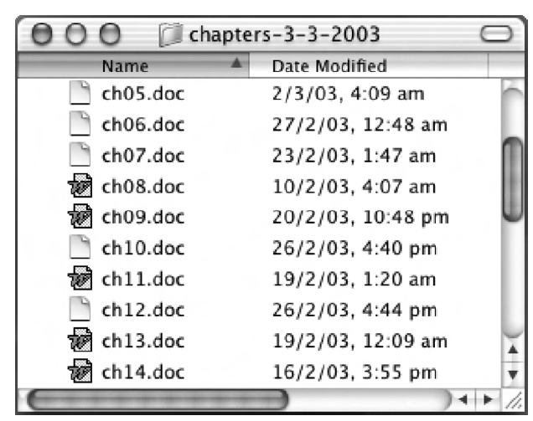
Presenting Information
Purpose matters
Sort order (which column, numeric alphabetic)
Text vs. Diagram
Scatter graph vs. Histogram
Use paper presentation principles!
But add interactivity
Softens design choices
E.g. Re-ordering columns
‘Dancing histograms’ (chap 21)
80

Slide 81

Aesthetics And Utility
aesthetically pleasing designs
increase user satisfaction and improve productivity
beauty and utility may conflict
mixed up visual styles ⇒ easy to distinguish
clean design – little differentiation ⇒ confusing
backgrounds behind text … good to look at, but hard to read
but can work together
e.g. the design of the counter
in consumer products – key differentiator (e.g. iMac)
81

Slide 82
Aesthetics And Utility (cont.)
Aesthetically pleasing designs
Increase user satisfaction and improve productivity
Beauty and utility may conflict
Mixed up visual styles ⇒ easy to distinguish
Clean design – little differentiation ⇒ confusing
Backgrounds behind text … good to look at, but hard to read
But can work together
E.g. The design of the counter
In consumer products – key differentiator e.g. sleek curves of a car.
82

Slide 83
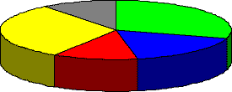
Colour And 3D
Both often used very badly!
Colour
Older monitors limited palette
Colour over used because ‘it is there’
Beware colour blind!
Use sparingly to reinforce other information
3D effects
Good for physical information and some graphs
But if over used … e.g. Text in perspective!! 3d pie charts
83

Slide 84
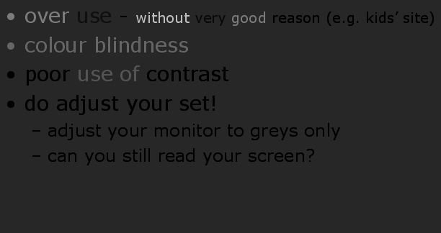
Bad Use Of Color
over use - without very good reason (e.g. kids’ site)
colour blindness
poor use of contrast
do adjust your set!
adjust your monitor to greys only
can you still read your screen?
84
Notes:
84

Slide 85
Across Countries And Cultures
Localisation & internationalisation
Changing interfaces for particular cultures/languages
Globalisation
Try to choose symbols etc. That work everywhere
Simply change language?
Use ‘resource’ database instead of literal text … but changes sizes, left-right order etc.
Deeper issues
Cultural assumptions and values
Meanings of symbols
E.g. tick and cross … +ve and -ve in some cultures … but … mean the same thing (mark this) in others
✔
🗶
85

Slide 86
Iteration And Prototyping
Getting better …
… and starting well
86

Slide 87
Prototyping
You never get it right first time
If at first you don’t succeed …
OK?
design
prototype
evaluate
done!
re-design
87

Slide 88
Pitfalls of Prototyping
Moving little by little … but to where
1. Need a good start point
2. Need to understand what is wrong
88

Slide 89
Thank You
89

